Slide 1
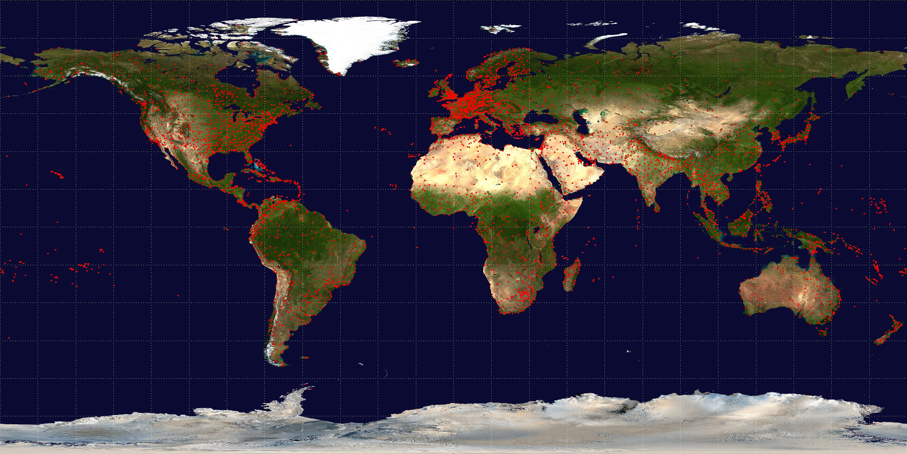
Flight Network Analysis
Team Members:
TAN CHOON KIAT (G1700699B)
TAN HONG GUANG (G1800654K)
LI LIQIAN (G1800749K)

Slide 2



INTRODUCTION
DATA EXPLORATION
METHODS
RESULTS
LIMITATIONS & FUTURE WORK
CONTENT

Slide 3

INTRODUCTION

Slide 4
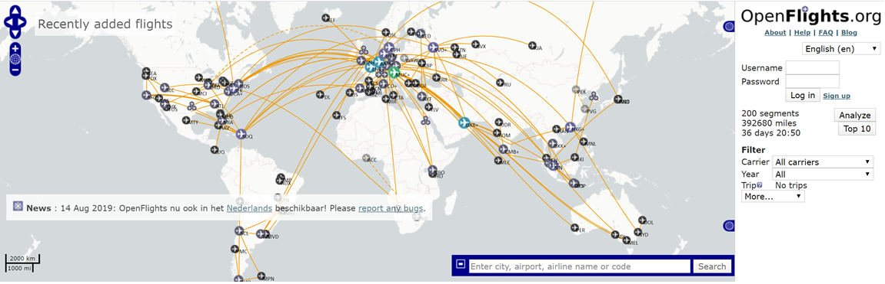
Motivation
What is OpenFlights?
Map your flights around the world, search and filter them
Calculate statistics automatically (e.g. Distance)
Share the resulting maps with friends and the world
Check airport route maps for nearly every airport in the world
Identify airlines that can travel to your destinations

Slide 5
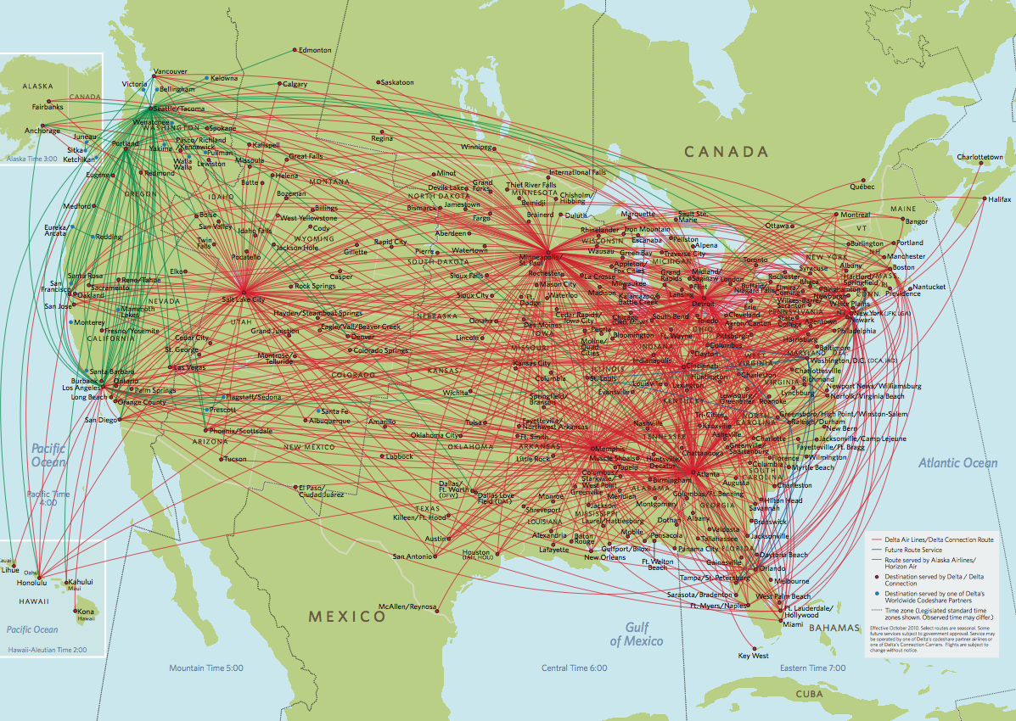
Problem Statement
Identify Air Hubs (Key Player) in the world (as of 2014) using OpenFlights Airports and Routes Database

Slide 6
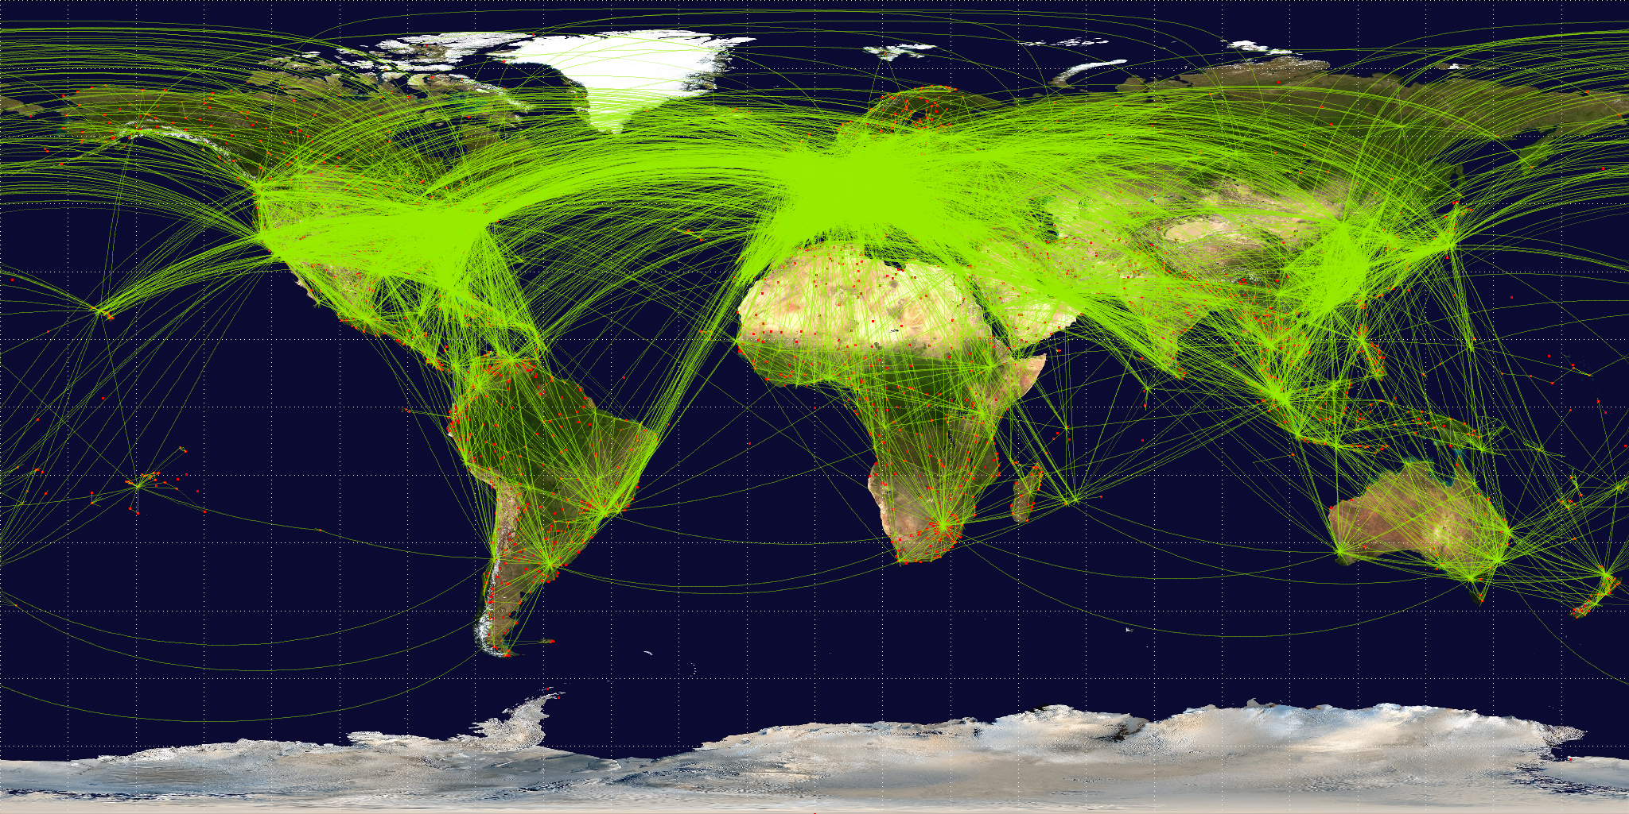
Data Description
Airport and routes data were extracted from https://openflights.org/data.html
OpenFlights Airports Database contains over 10,000 airports, train stations and ferry terminals spanning the globe. Only type=airport is included in this project airports.dat
Covers over 3,000 airports and 60,000 routes
Routes data updated as of June 2014 routes.dat

Slide 7
Methodology
Data Exploration
Pre-processing Stage
Output Stage
Analysis Stage
Input Stage
Drop Source airport ID and Destination airport ID with NULL values
Treat airports as nodes
Create routes from Source airport ID to Destination airport ID
Perform several Community Detection algorithms using R (iGraph)
Use Modularity as measure of quality to select the best algorithm
Utilise various evaluation metrics to identify key player(s) within communities
Analyse the characteristics of the key player(s)
Extract Airports and Flight Routes Data from openflights.org

Slide 8
DATA EXPLORATION

Slide 9
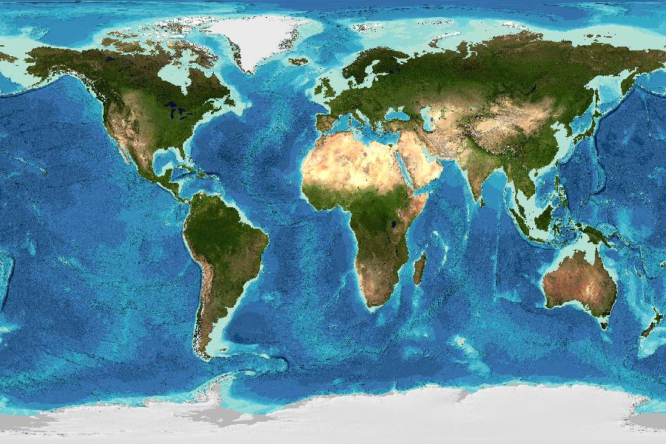
Preliminary Data Exploration (1)
3,218 Airports with 66,771 Routes operated by 547 Airlines
Average total degree
41.55
Average in/out degree
20.78
Mean path length
3.98
Network diameter
13
Global clustering coefficient
0.25
Density
0.006

Slide 10
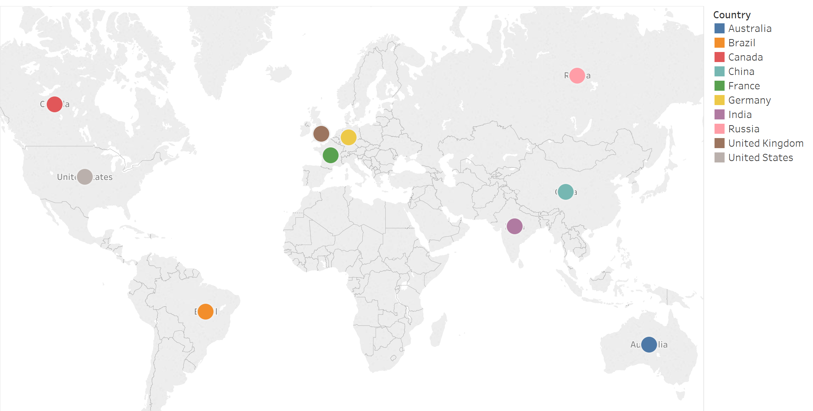
Preliminary Data Exploration (2)
Number of Airports within each Country
9. United Kingdom
(167)
5. Russia
(264)
2. Canada
(430)
6. Germany
(249)
United States
(1,512)
7. China (241)
8. France
(217)
4. Brazil
(264)
10. India
(148)
3. Australia
334

Slide 11
Preliminary Data Exploration (3)
Popular Routes operated by different Airlines
S/N | START AIRPORT | COUNTRY | END AIRPORT | COUNTRY | NO. OF AIRLINES
1 | Chicago O'Hare International Airport | United States | Hartsfield Jackson Atlanta International Airport | United States | 20
2 | Hartsfield Jackson Atlanta International Airport | United States | Chicago O'Hare International Airport | United States | 19
3 | Phuket International Airport | Thailand | Suvarnabhumi Airport | Thailand | 13
4 | Chicago O'Hare International Airport | United States | Louis Armstrong New Orleans International Airport | United States | 13
5 | Hamad International Airport | Qatar | Faro Airport | Canada | 12
6 | Abu Dhabi International Airport | United Arab Emirates | Muscat International Airport | Oman | 12
7 | Hong Kong International Airport | Hong Kong | Suvarnabhumi Airport | Thailand | 12
8 | Guangzhou Baiyun International Airport | China | Hangzhou Xiaoshan International Airport | China | 12
9 | Miami International Airport | United States | Hartsfield Jackson Atlanta International Airport | United States | 12
10 | Hartsfield Jackson Atlanta International Airport | United States | Miami International Airport | United States | 12
Domestic
Flights
International
Flights
Domestic
Flights

Slide 12
Preliminary Data Exploration (4)
United States
China

Slide 13
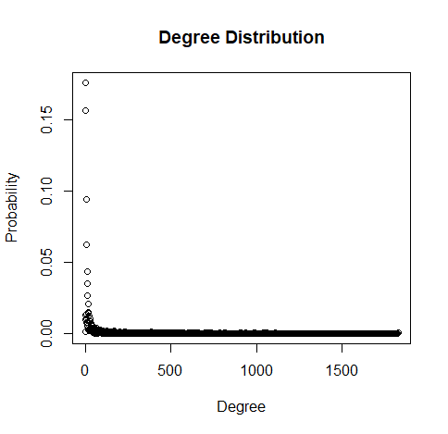
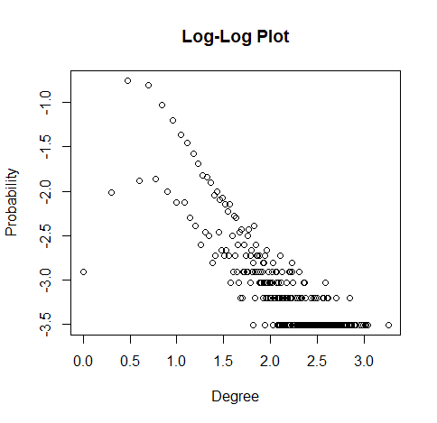
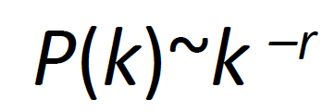
Degree Distribution follows Power Law
Preliminary Data Exploration (5)
Scale-free Network

Slide 14
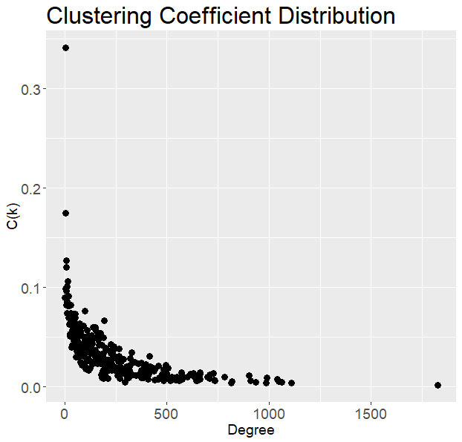
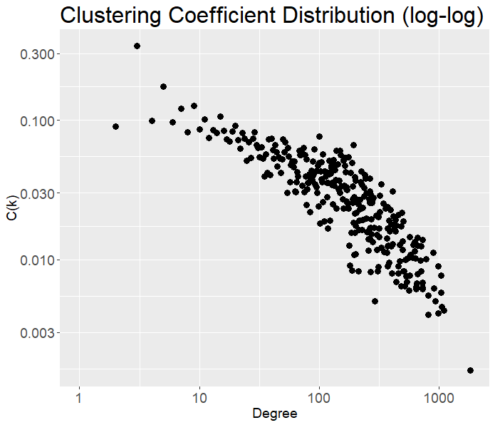
Preliminary Data Exploration (6)
Hierarchical Network

Slide 15
METHODS

Slide 16
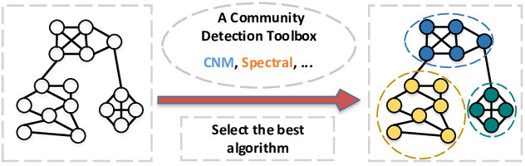
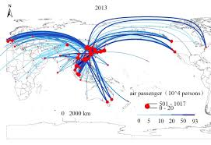
Community Detection Algorithm (1)
Spinglass
Label Propagation
Walktrap
Louvain

Slide 17
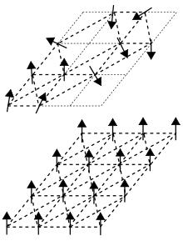
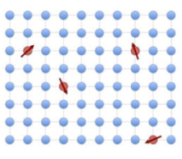

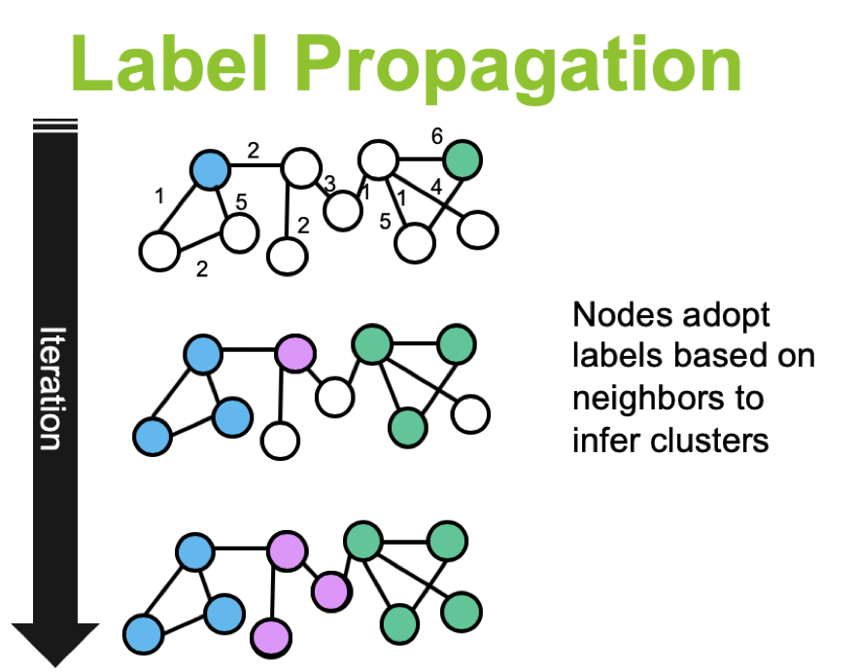
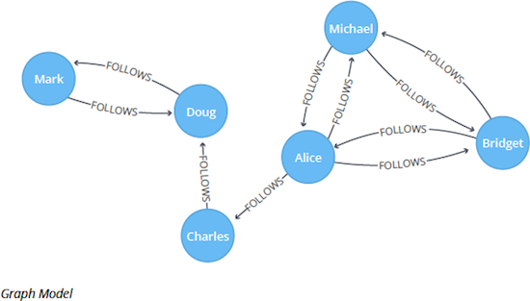
Community Detection Algorithm (2)
METHODS | DETAILS | PROS | CONS
1. Spinglass | - An approach from statistical physics. - Each particle (node) can be in one of c spin states - Interactions between the particles (edges) specify which pairs of nodes would prefer to stay in the same spin state and which ones prefer to have different spin states. - The model is then simulated for a given number of steps, and the spin states of the particles in the end define the communities | - Can use for negatively-weighted edges - Good detection | - Not particularly fast and not deterministic
2. Label Propagation | -Every node is assigned with unique labels. -Then updates these labels by choosing the label assigned to the majority of their neighbors -Repeat this iteratively until each node has the most common labels among its neighbors | - Very fast | - Yields different results based on the initial configuration (which is decided randomly)

Slide 18
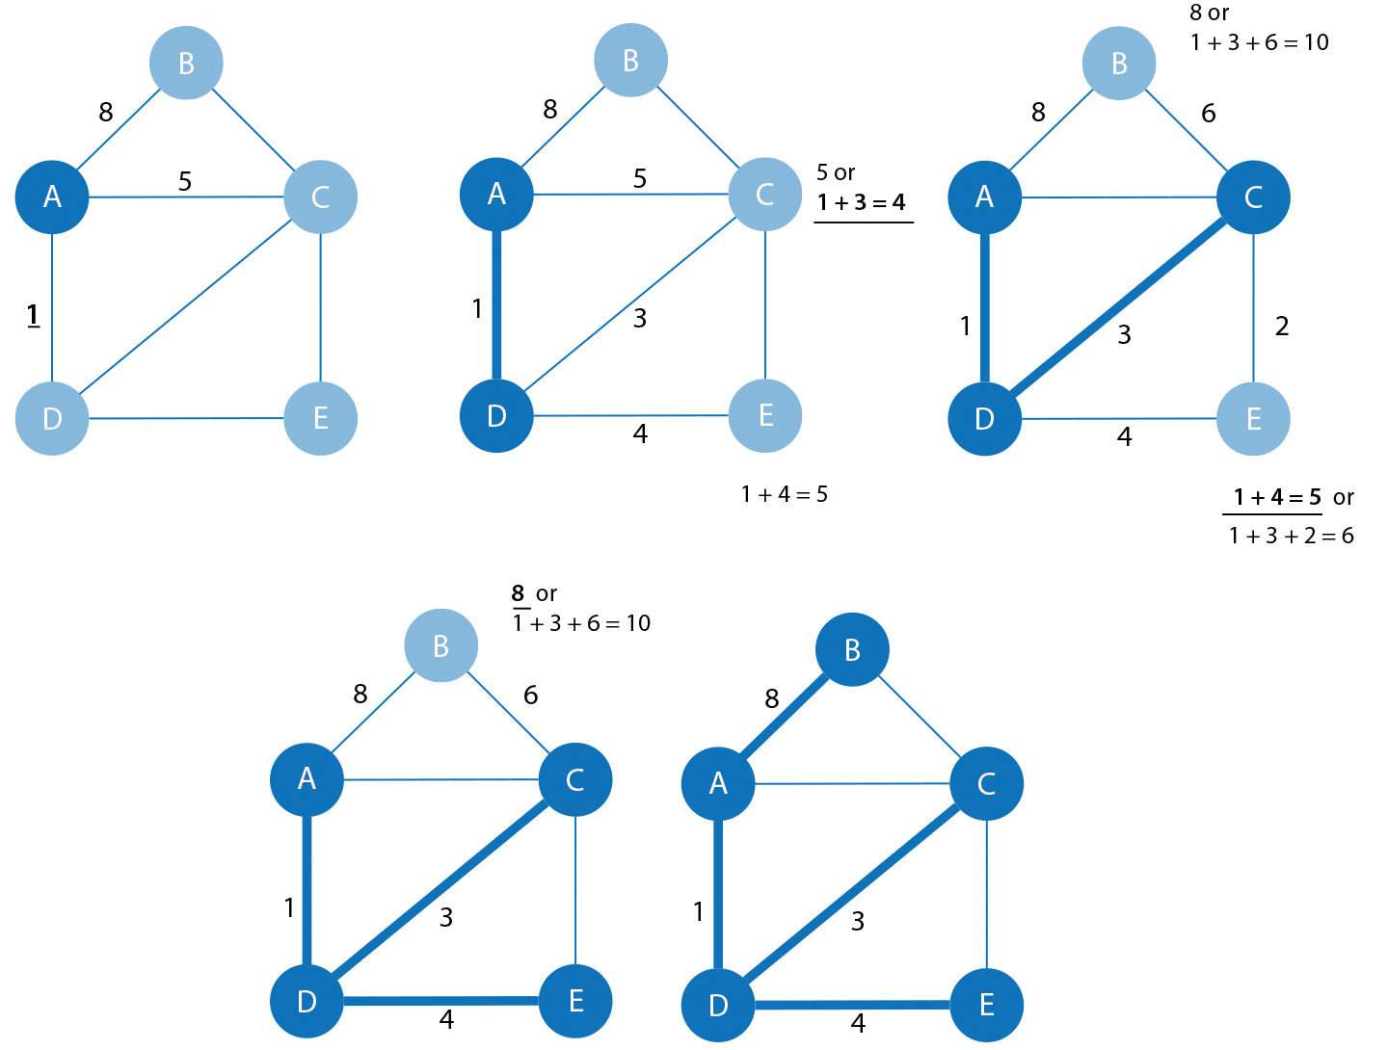
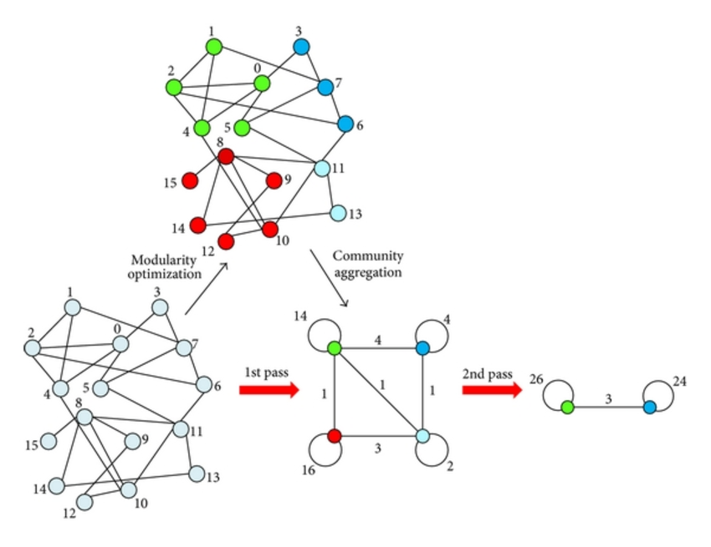
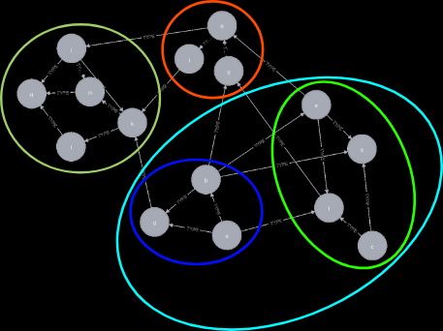
Community Detection Algorithm (3)
METHODS | DETAILS | PROS | CONS
3. Walktrap | - An approach based on random walks. - The walks are more likely to stay within the same community because there are only a few edges that lead outside a given community. - It runs short random walks of 3-4-5 steps (depending on one of its parameters) and uses the results of these random walks to merge separate communities in a bottom-up manner | - Fast - Can use for directed graphs | - May not perform well for large network
4. Louvain | - Heuristic approach, based on the modularity, which measures the density of edges inside communities to edges outside communities. - First small communities are found by optimizing modularity locally on all nodes - Then each small community is grouped into one node - The two phases that are repeated iteratively | -Simple, efficient and easy-to-implement method for identifying communities in large networks | - May yield arbitrarily badly connected communities

Slide 19
RESULTS

Slide 20
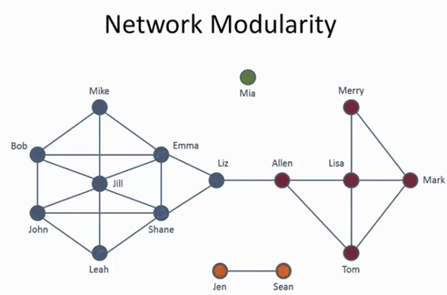
Quality of Communities Detected
Several measures for quantifying the quality of communities have been proposed
Modularity
Centrality/Betweenness
Clustering coefficient
Density/Diameter/Link distribution etc.
Modularity is one of the most used known function to quantify community structure in graph
Larger modularity Q indicates better communities (more than random intra-cluster density)
The community structure would be better if the number of internal edges exceed the expected number
Modularity is normalized and it ranges from -1 to 1
Positive means the number of edges within groups exceeds the number expected on the basis of chance
Negative values means there is no community structure

Slide 21
Results
Methods/ Algorithms | No of Communities Detected | Modularity
1. Spinglass | 22 | 0.387
2. Label Propagation | 87 | 0.604
3. Walktrap | 186 | 0.629
4. Lourvain | 39 | 0.640

Slide 22

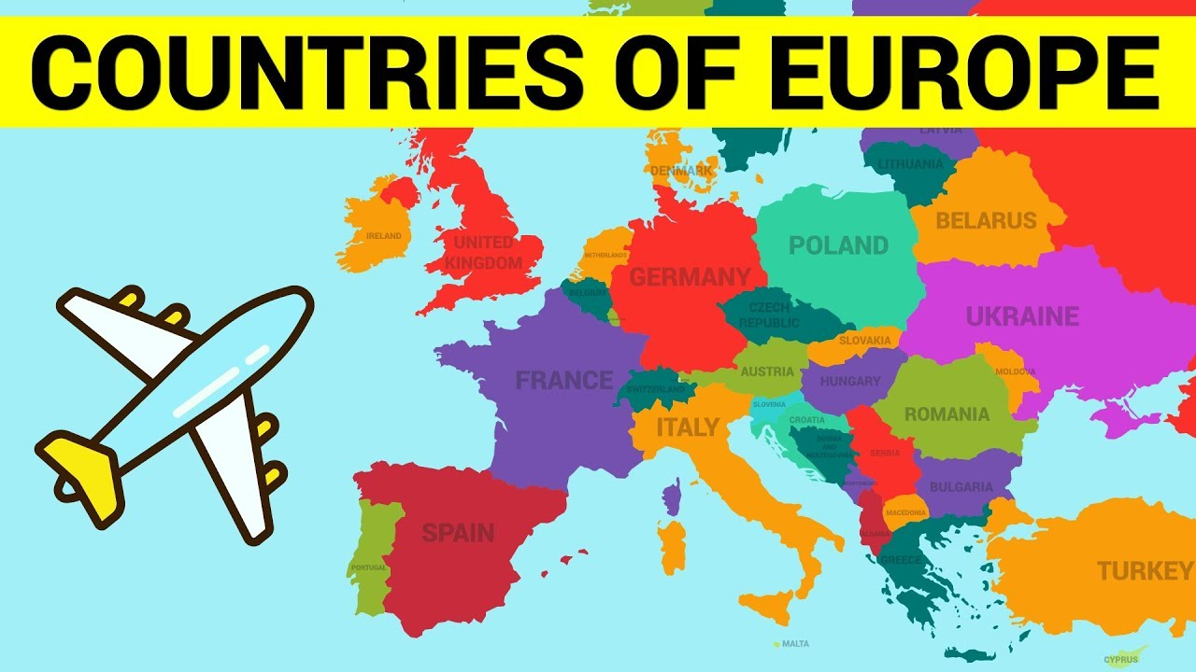
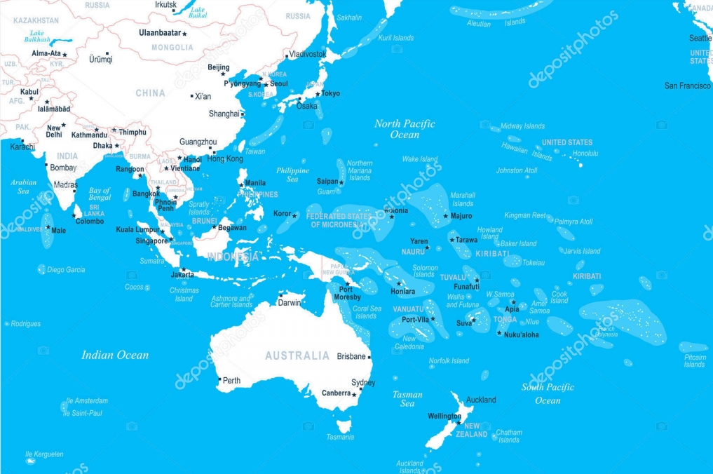
3 main communities detected using Louvain algorithm
North America &
South America
Europe
Asia & Oceania

Slide 23
Why is identify Key Players/Airports important?
From Airports’ perspective
Learn from the key player on how they manage the flights. Upgrade their air navigation systems and procedures to handle more traffic
From Airlines’s perpective
More reliable services provided by the airport such as maintenance of their planes and refuelling services etc
Possible new destinations for airlines to consider to increase their revenue and travel options for travellers

Slide 24



Key Airports
for
North America &
South America
759 airports (nodes)
 | Hartsfield Jackson Atlanta International Airport | Dallas Fort Worth International Airport | Chicago O'Hare International Airport
Degree | 1,703 | 834 (Third) | 900 (Second)
Closeness | 0.533 | 0.532 (Second) | 0.512 (Forth)
Betweenness | 0.000970 | 0.000621 (Second) | 0.000530 (Fifth)
PageRank | 0.0415 | 0.0229 (Third) | 0.0234 (Second)
Authority Score | 1 | 0.476 (Forth) | 0.593 (Second)
Hub score | 1 | 0.466 (Forth) | 0.603 (Second)

Slide 25
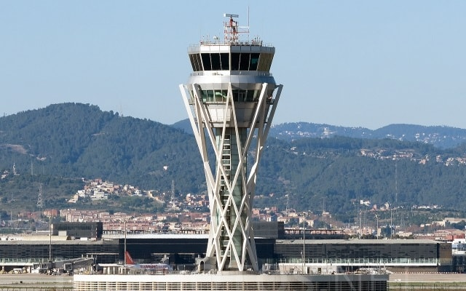

 | Barcelona International Airport | Amsterdam Airport Schiphol
Degree | 706 | 604 (Second)
Closeness | 0.263 | 0.262 (Second)
Betweeness | 0.000206 (Fifth) | 0.000146 (Tenth)
PageRank | 0.0155 | 0.0130 (Third)
Authority Score | 1 | 0.832 (Third)
Hub score | 1 | 0.844 (Second)
Key Airports
for
Europe
601 airports (nodes)

Slide 26


Key Airport for
Asia & Oceania
554 airports (nodes)
 | Singapore Changi Airport | Kuala Lumpur International Airport
Degree | 496 | 350 (Fifth)
Closeness | 0.1635 (Third) | 0.1643 (First)
Betweeness | 0.000596 | 0.000314 (Sixth)
PageRank | 0.0262 | 0.0180 (Seventh)
Authority Score | 1 | 0.743 (Second)
Hub score | 1 | 0.748 (Second)

Slide 27
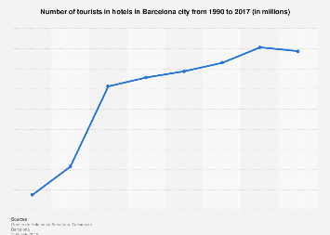


Why makes them the Key Airport?
Hartsfield Jackson Atlanta International Airport
has been the world's busiest airport by passenger traffic since 1998. It is the primary hub of Delta Air Lines, and is a focus city for low-cost carriers Frontier Airlines, Southwest Airlines, and Spirit Airlines. With just over 1,000 flights a day to 225 domestic and international destinations, the Delta hub is the world's largest airline hub.
Most of the traffic at Barcelona Airport is domestic and European, in which Vueling has an operational base. Low-cost airline traffic grew significantly, especially after the creation of operating bases by Vueling and Clickair at the airport. Number of tourists increase significantly from 1990 to 2017 as shown above.
Singapore Changi Airport is one of the largest transportation hubs in Asia. Air traffic growth in the Asia-Pacific region is one of the fastest in the world. Singapore is strategically located at the heart of the region, and is well-placed to benefit from the growth potential of aviation-related activities.

Slide 28
LIMITATIONS & FUTURE WORK

Slide 29
Limitations
The edges we used in our analysis are not weighted (Can consider using volume of passenger as weight).
Only analyse commercial flights. Missing out another category: cargo flights.
Could have tried more methods/algorithms in detecting communities.

Slide 30
Future Work
We could find out which cluster is totally deserted, propose for airlines to consider for new destination.
Classify flights as Domestic or International. An airport might have high degree due to many Domestic flights.
Use other community detection algorithms such as Girvan-Newman, fast and greedy method or Leiden algorithm to see which better suits the aviation network

Slide 31

Conclusion
Different Key Airport could be identified depending on their geographical locations
With the advancement of technology, Aviation has become an important industry.
Identify Key Airport can be useful for different stakeholders in the aviation industry
Airlines: Possible new destinations, receive reliable services (eg maintenance/ refuelling services), better equipment and procedures used to provide safe and efficient air traffic services for aircrafts
Airports: Learn from Air Hubs to increase flight frequencies, passenger arrivals etc
Aviation-related (eg tow-thruck/maintenance) companies: Invest more resources in Air Hubs.

Slide 32
References
https://stackoverflow.com/questions/9471906/what-are-the-differences-between-community-detection-algorithms-in-igraph
https://en.wikipedia.org/wiki/Louvain_modularity
https://en.wikipedia.org/wiki/Hartsfield%E2%80%93Jackson_Atlanta_International_Airport
https://www.mot.gov.sg/about-mot/air-transport/aviation-hub

Slide 33


